Slide 1
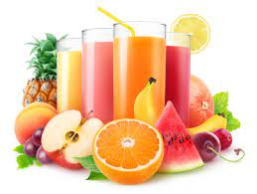
PROJECT ON ENTREPRENEURSHIP
development of MIXED FRUIT JUICE PVT. LTD.
GUIDED BY :-
DR. APURBA GIRI (Assistant Professor and Head)
AYAN MONDAL (Assistant Professor)
Dept. of Nutrition
Mugberia Gangadhar Mahavidyalaya
Projected BY : - SOUMYADEEP MAITY
B.Voc (Food Processing,6th Sem)
Dept. of Nutrition
Mugberia Gangadhar Mahavidyalaya

Slide 2
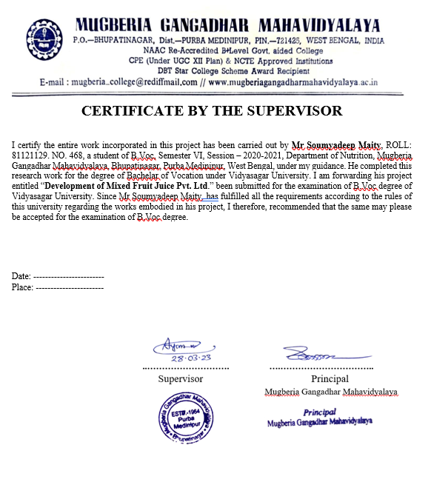

Slide 3
INTRODUCTION
Mixed fruit juice is a juice made from liquid squeezed out from fruits that includes apple, pineapple, watermelon, mango. It is considered as a healthy and nutritious beverage and can be consumed chilled.
Mixed Fruit Juice is packed with Vitamin C, iron & dietary fibre. It's termed as a natural energizer & also aids in weight management.

Slide 4
MIXED FRUIT JUICE MANUFACTURING
INVESTMENT LOCATION BUSINESS RESEARCH RAW METERIAL MACHINEry AREA MANPOWER COUSTOMERS LICENSES PROFIT MARKET STRATEGY
Layout

Slide 5
BUISNESS RESEARCH
DEMAND
SUPPLY
PRICE
QUANTITY
QUALITY

Slide 6
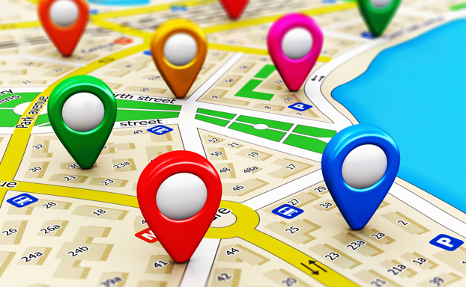
SELECTION OF PLANT LOCTION
Establishing a Small scale Industries of Sugarcane juice plant are ready a minimum 13500 SQ FT . If possible, select the location that comes in close proximity to the marketing distribution areas. This way, it will become easier to reduce the overall transportation cost .

Slide 7
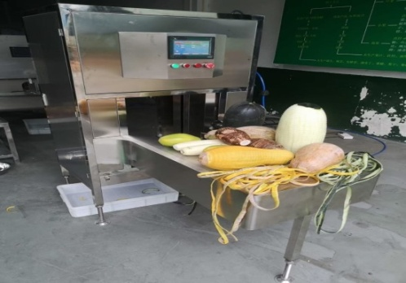
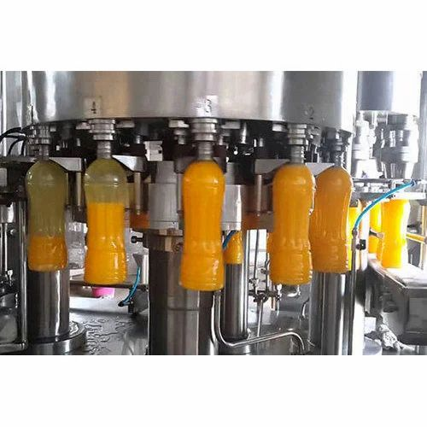
MACHINERY
Blender Machine
Peeler
Juice Extractor
pasteurization
Sealing Machine

Slide 8
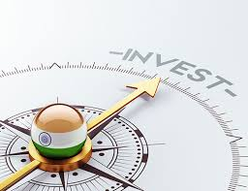
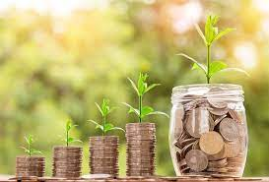
INVESTMENT
CAPITAL 7 - 8 LAKHS
PROFIT
DEPENDS ALSO PRODUCTION
PRODUCT QUALITY
BUISNESS MODEL

Slide 9
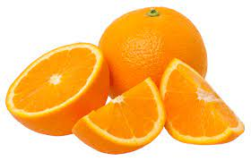
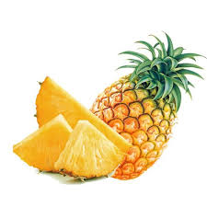
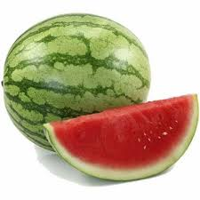
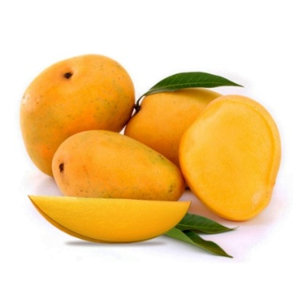
RAW MATERIAL
orange, pineapple, watermelon, Mango
Packaging Material ( bottle, tetrapack )
Flavour
Preservative

Slide 10
LICENSES
REGISTRATION OF BUSINESS NOC PAPER(FORM STATE POLLUTION CONTROL,SOUND AND WATER) TRADE LICENSES GST(Goods & Service Tax) FSSAI(Food Safety and Standards Authority of India)
SMALL SCALE INDUSTRY LICENSE REGISTRATION FOR TRADEMARK

Slide 11
PROCESSING FLOW CHAT
SELECTION OF GOOD FRUIT
SOAKING AND WASHING
PEELING
JUICE EXTRACTION
FILTRATION
ADD FLAVOUR AND PRESERVATIVES
PASTEURIZATION( 65 DEGREE 15 MIN)
COLLING
FILLING(BOTTLING)
STORE IN (REFRIGERATOR)

Slide 12
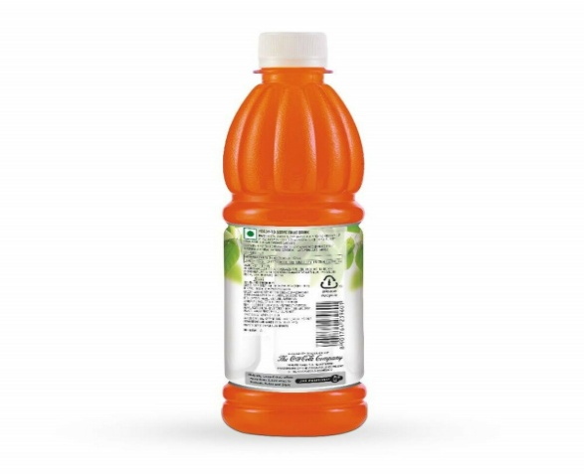
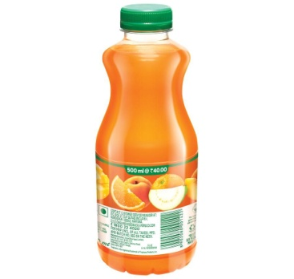
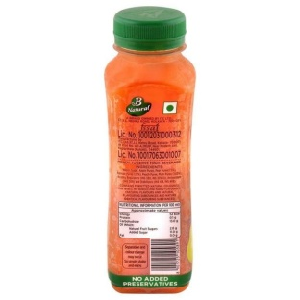
PACKAGING SIZES AND PRICE
1 liter = 82
500 ml= 40
250ml = 20

Slide 14
MARKETING STRATEGIES
LOCAL MARKET ANNOUNCEMENTS
ADVERTISING
DIGITAL MARKETING
DIRECT MARKETING

Slide 15
TARGET CUSTOMERS
WHOLEESALERS
DISTRIBUTORS
RETAILERS
Sweet shop
ONLINE SHOPPING
ONLINE : Flipkart, Amazon, Snapdeal

Slide 16
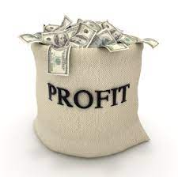
PROFIT
Depends on production and selling
MAN POWER
9 - 10 STAFF

